Slide 1

Lesson: Receiving certificates

Slide 2
Overview
Issued automatically when course completion criteria are met (e.g., finish all lessons/quiz).
Personalized with learner name, course title, completion date.
Visible in the learner’s Profile → Certificates.
Downloadable as a PDF.
Admins can set criteria and choose a certificate template.
Admins can re-issue or revoke a certificate if needed.

Slide 3
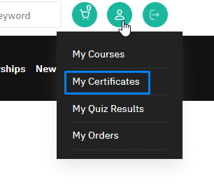
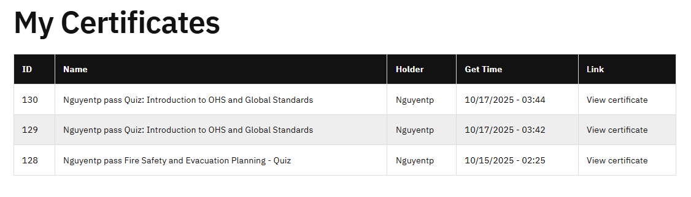
2. My Certificate
You can review the certificates you have achieved in the menu bar My account > My certificates

Slide 4
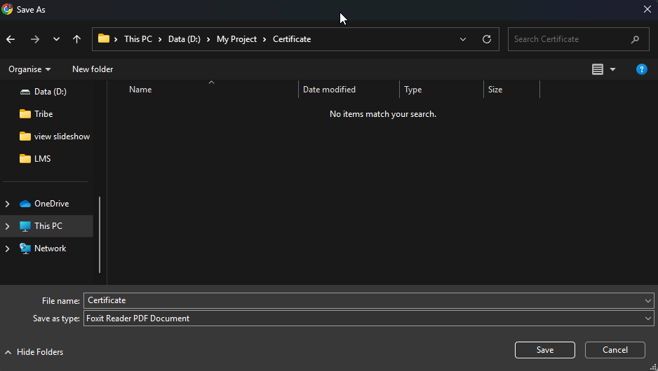
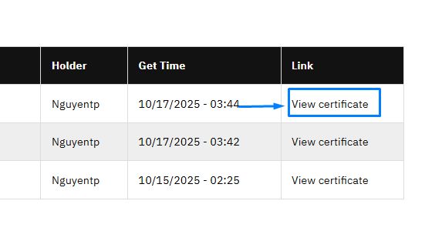
2. Download Certificate
Click view certificate to download file to desktop

Slide 5
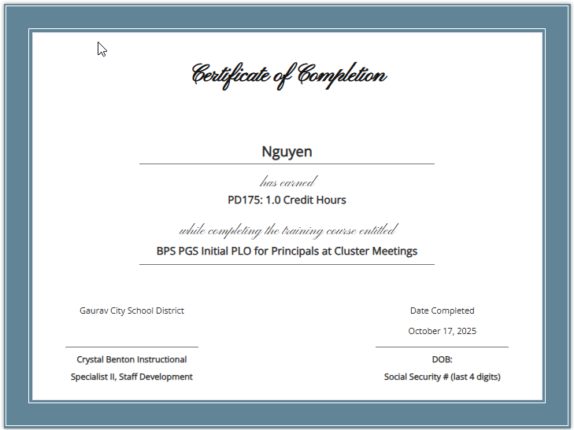
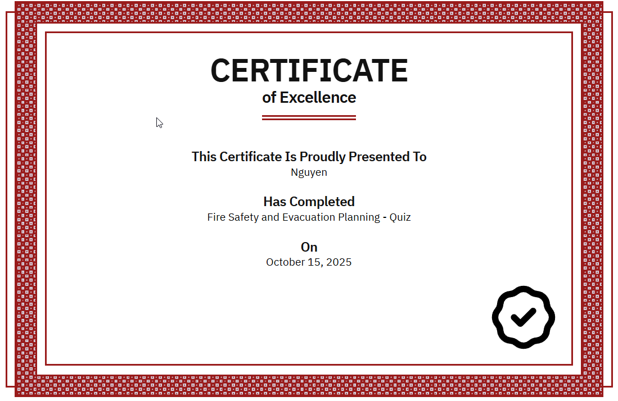
4. Certificate
You will receive a downloadable certificate of completion.

Slide 6
Thank you

